Slide 1

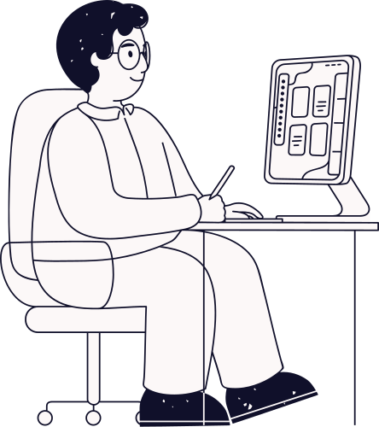
Designing user interface
Best practices in UI/UX
Presented By :
Presented To :
Md. Aayat Hossain Mridha (ID- 2023100000457)
Sumya Akter Asha (ID- 2023100000369)
Umme Ayrin Tithi (ID- 2023100000377)
Shimul Dey Katha
Lecturer, Department of CSE
Southeast University.

Slide 2
Introduction to UI & UX
01
Best Practices in Visual Design
02
Principles of Good UI/UX Design
03
Overview
Interaction Design
04
Usability Testing
05
Accessibility & Inclusive Design
06
Current Trends in UI/UX
07
Conclusion
08

Slide 3
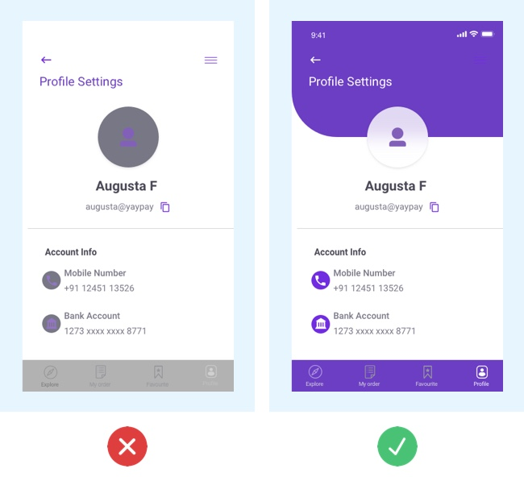
Quick Question
01
02
03
04
05
06
07
08

Slide 4
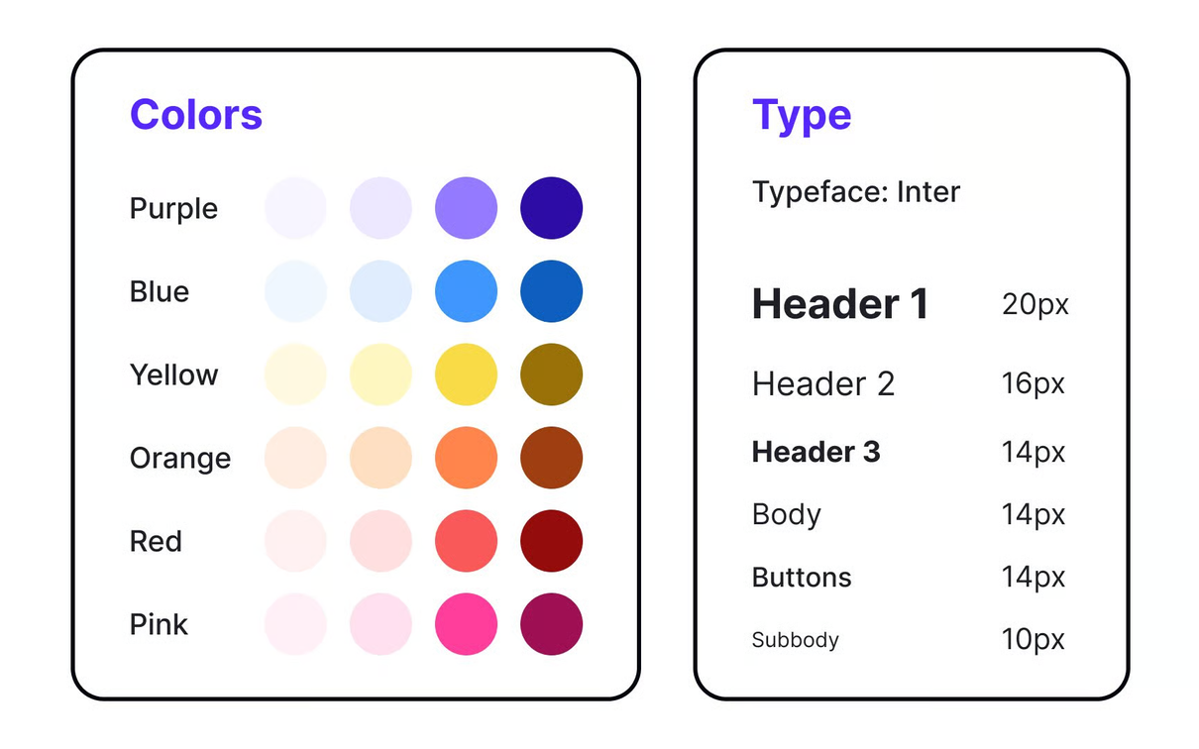

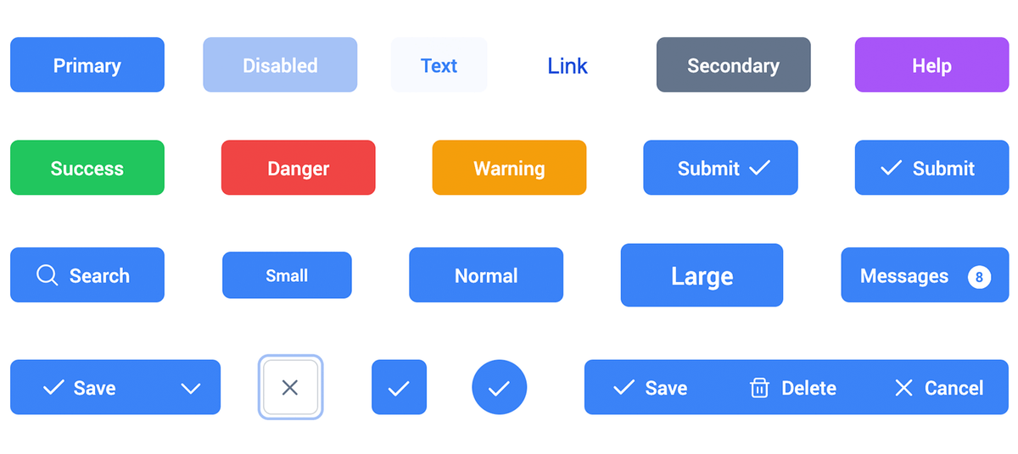
Introduction To UI & UX
User Interface(UI)
Visual elements users interact with
Examples Include – layouts, buttons, colors, typography etc.
Good UI makes a product look clear and attractive.

Slide 5

Introduction To UI & UX
User Experience(UX)
Overall feeling and satisfaction a user gets while interacting with a product.
Focuses on usability, accessibility, and efficiency of the entire journey.
Good UX ensures products are easy, enjoyable, and valuable to use.

Slide 6
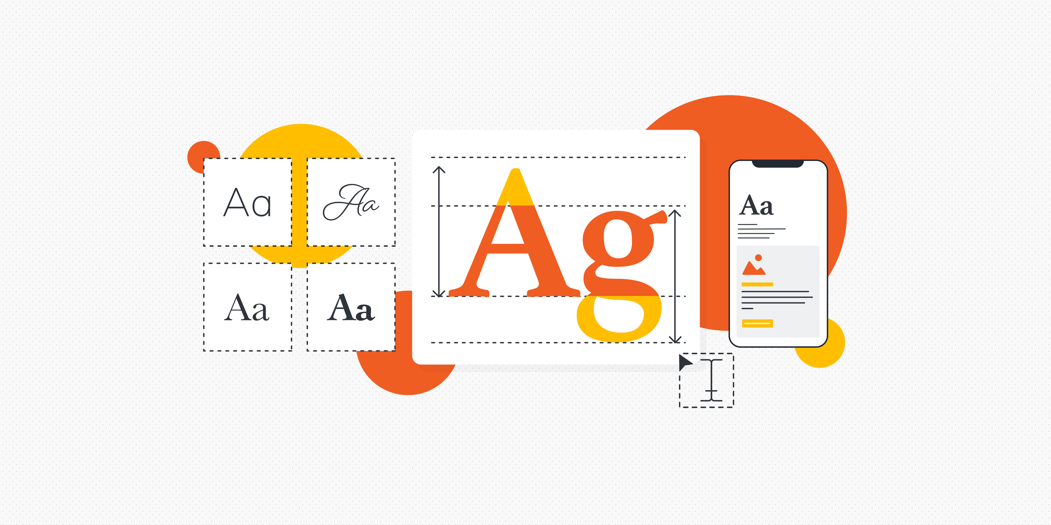
Visual Design Best Practices
Typography Choices
Clear and legible fonts should be selected
Consistent styles and sizes
Use different font weights to highlight important text.

Slide 7
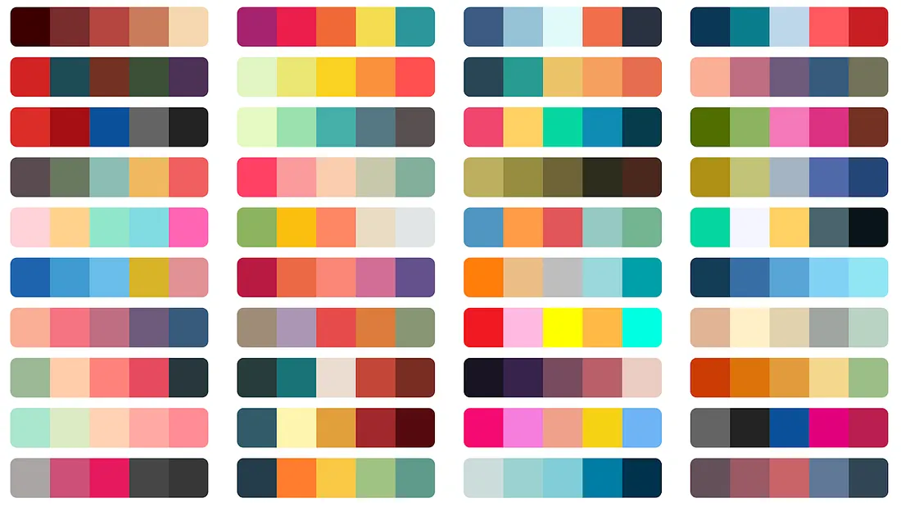
Visual Design Best Practices
Color Theory
and Contrast
Color palette that creates the right mood and strengthens brand identity
High contrast between text and its background
Contrast also acts as a visual cue, directing attention to key actions and information.

Slide 8
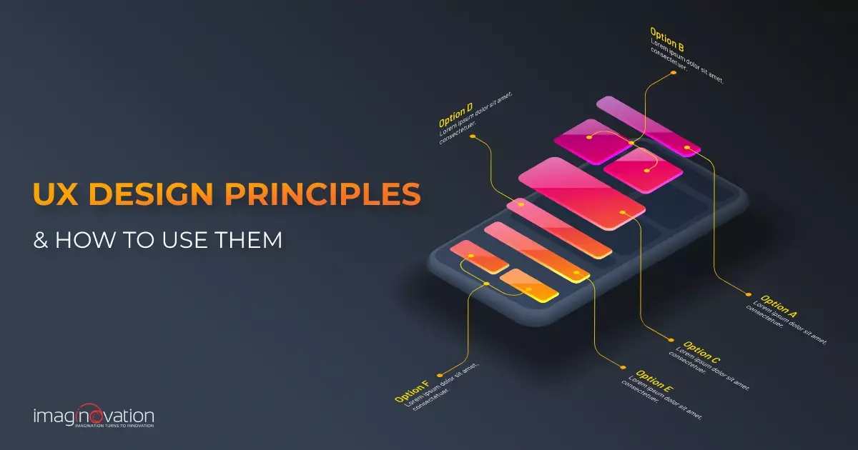



Principles of UI/UX Design
Seven Fundamental Elements That Shape User Experience
The Essential Pillars of User Interface Design, there are 7 of them

Slide 9



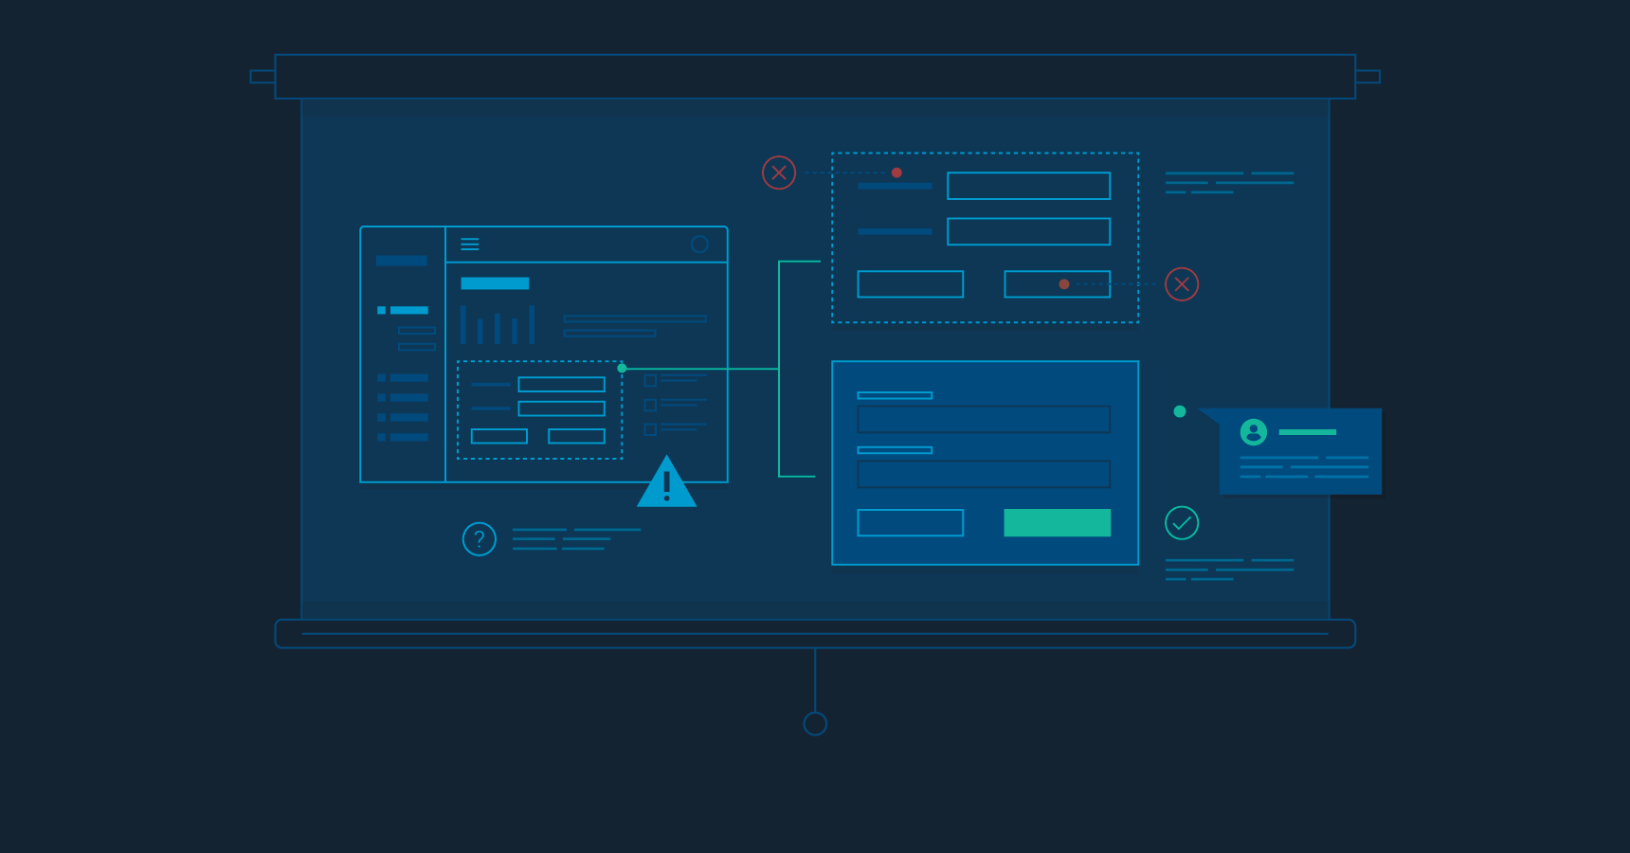
INTERACTION DESIGN.
There are differnt type of interactive elements
BUTTON
LINKS
FORMS
MENU

Slide 10

USABILITY TESTING
Prototypes are early versions of a product that show how it will look and work.
(low fidelity and high-fidelity)
Iterative improvement based on feedback
Feedback is the lifeblood of any successful system. Whether you're designing a loyalty checkout process or fine-tuning a rocket engine feedback provides essential insights

Slide 11



Accessibility & Inclusive Design
Accessibility means making products easy for everyone to use. When designers focus on this, they create apps and experiences that work for all people.
Designing for people with disabilities (WCAG guidelines):
Visual disabilities
Auditory disabilities
Motor disabilities
Cognitive disabilities

Slide 12


Accessibility & Inclusive Design
Keyboard Navigation
Alt Text
Color Blindness Consideration
By following these rules, UI/UX design becomes easier, clearer, and equally usable for everyone

Slide 13

Current Trends in UI/UX
1. Interactive 3D Objects
2. AI interfaces and presence
3. Text & Emoji mix
4. Text transition
etc....

Slide 14

Conclusion
Best Practices in UI/UX means making apps and websites easy and enjoyable for everyone.
Designs should be simple, clear, and work for all users, including those with disabilities. Easy navigation, clear instructions, and helpful feedback make using a product smooth.

Slide 15




Thank You
So Much

